Slide 1

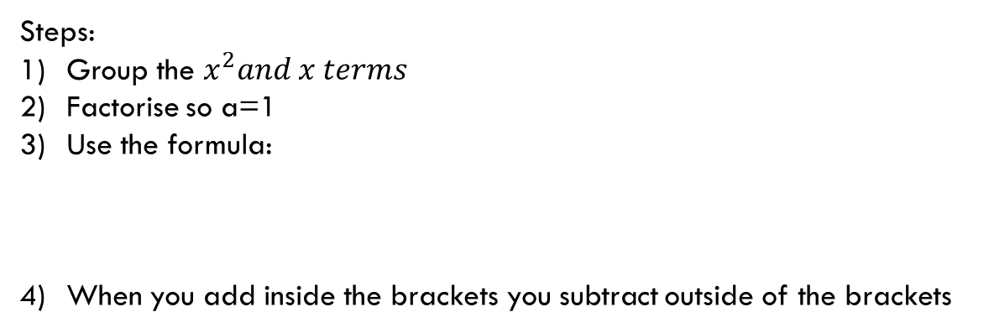

TOPIC: Completing the square to use vertex form
EQ: What is vertex form?
How to form a vertex?
Some quadratics will not form vertex squares, so what do we do? You’ll need to create the bimodal square.
Vertex Form:
$${y=ax}^{2}+bx+c$$
y = a(x – h)² + k
Steps:
Group the $x^{2}and x terms$
Factorise so a=1
Use the formula:
When you add inside the brackets you subtract outside of the brackets
$$(\frac{b}{2})^{2}$$

Slide 2



TOPIC: Completing the square to use vertex form
EQ: What is vertex form?
Example:
$${y=x}^{2}+2x−3$$
Group the $x^{2}and x terms$
$${y=(x}^{2}+2x)−3$$

Slide 3




TOPIC: Completing the square to use vertex form
EQ: What is vertex form?
$${y=(x}^{2}+2x)−3$$
Use the formula:
$$(\frac{b}{2})^{2}$$
$(\frac{2}{2})^{2}$= 1
Now you need to add 1 inside of your bracket. But whenever you add a number inside the parenthesis. You need to subtract the same number outside of the parenthesis.
$${y=(x}^{2}+2x+1)−3−1$$

Slide 4


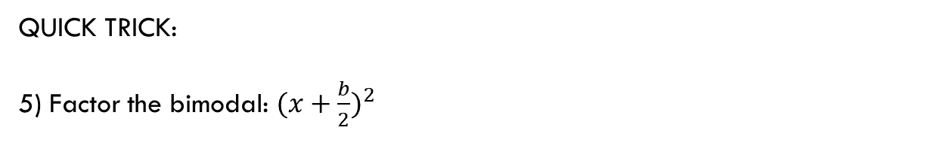
TOPIC: Completing the square to use vertex form
EQ: What is vertex form?
$${y=(x}^{2}+2x+1)−3−1$$
QUICK TRICK:
5) Factor the bimodal: $(x+\frac{b}{2})^{2}$
$$y=(x+1)^{2}−4$$
Vertex: (-1, -4)

Slide 5

TOPIC: Completing the square to use vertex form
EQ: What is vertex form?
Example:
Try this one yourself!
$${y=x}^{2}−6x+2$$
Steps:
Group the $x^{2}and x terms$
Factorise so a=1
Use the formula:
When you add inside the brackets you subtract outside of the brackets
$$(\frac{b}{2})^{2}$$

Slide 6







TOPIC: Completing the square to use vertex form
EQ: What is vertex form?
Example:
$${y=x}^{2}−6x+2$$
$${y=(x}^{2}−6x)+2$$
$$(\frac{b}{2})^{2}$$
$(\frac{−6}{2})^{2}$= 9
$${y=(x}^{2}−6x+9)+2−9$$
5) Factor the bimodal: $(x+\frac{b}{2})^{2}$
$$y=(x−3)^{2}−7$$

